Slide 1
Data Structures ICT-1211 Information and Communication Technology
Lecture-32
Date: //

Slide 2
Sorting and Searching

Slide 3
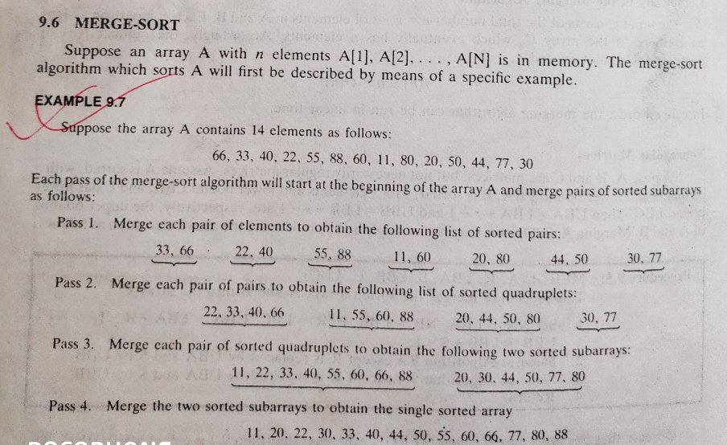
Sorting and Searching

Slide 4
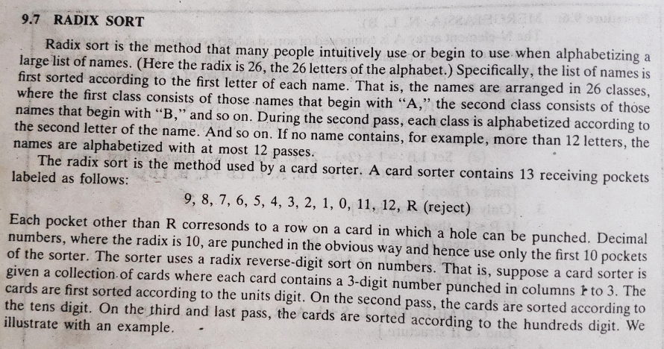
Sorting and Searching

Slide 5
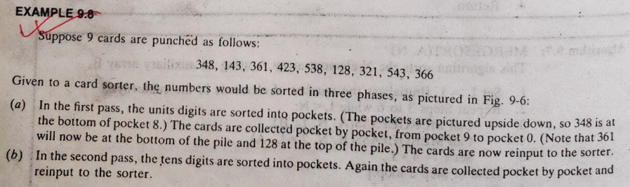
Sorting and Searching

Slide 6
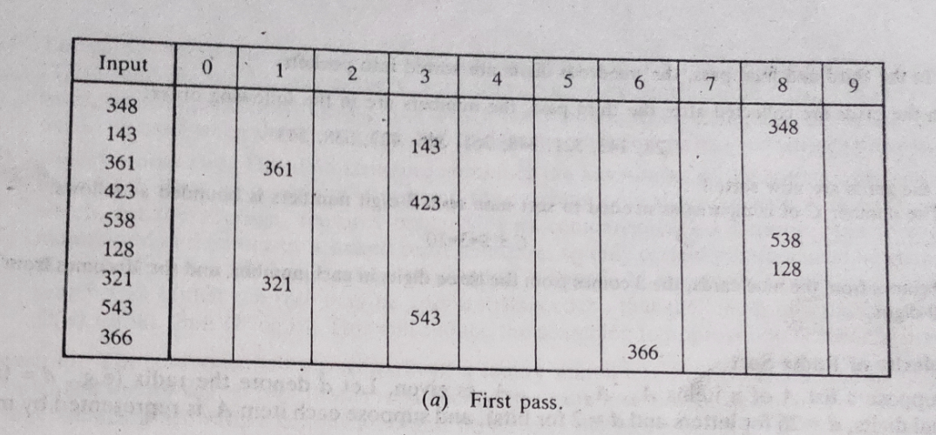
Sorting and Searching
After first pass: 361, 321, 143, 423, 543, 366, 348, 538, 128

Slide 7
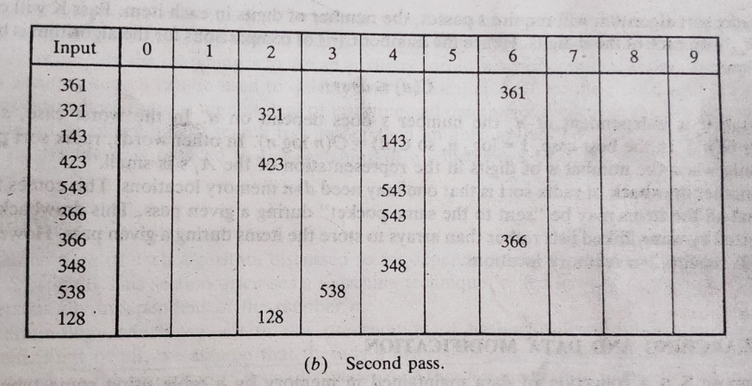
Sorting and Searching
After second pass: 321, 423, 128, 538, 143, 543, 348, 361, 366

Slide 8
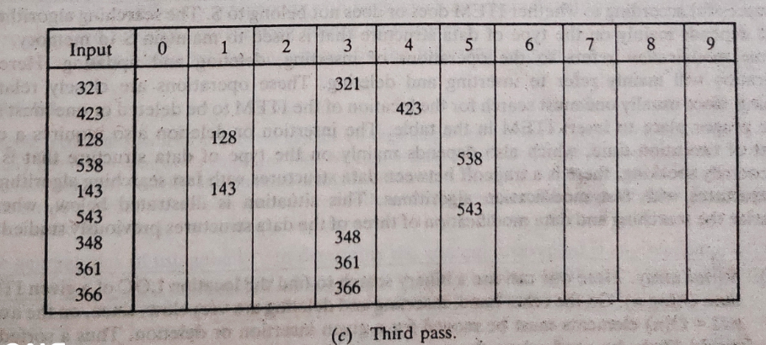
Sorting and Searching
After third pass: 128, 143, 321, 348, 361, 366, 423, 538, 543

Slide 9
Hashing
Hashing is a technique that is used to uniquely identify a specific object from a group of similar objects. Some examples of how hashing is used in our lives include:
In universities, each student is assigned a unique roll number that can be used to retrieve information about them.
In libraries, each book is assigned a unique number that can be used to determine information about the book, such as its exact position in the library or the users it has been issued to etc.
In both these examples the students and books were hashed to a unique number.

Slide 10
Hashing
Assume that you have an object and you want to assign a key to it to make searching easy. To store the key/value pair, you can use a simple array like a data structure where keys (integers) can be used directly as an index to store values. However, in cases where the keys are large and cannot be used directly as an index, you should use hashing.

Slide 11
Why Hashing?
Imagine you run a company with 20,000 employees. Also imagine you have an up-to-date table called Employees that contains key personal information like first name, last name, address, salary, and so on. If you were to run a query to retrieve personal information for the employee with the last name Ziganto, how long would it take?

Slide 12
Why Hashing?
It depends how you stored the table. If you stored it as a list of lists where your master list is the table and the sub lists include key information about each individual employee, then your lookup time can be very long. How long exactly? You have to consider the worst case scenario. Here, there are 20,000 employees. Let’s assume the table is sorted alphabetically by last name.

Slide 13
Why Hashing?
Therefore, Ziganto is somewhere near the end, maybe even the last entry. The best we can do with this type of table is a linear search, meaning we check to see if the first entry for last name is Ziganto. If it is, great, we can stop. If not, move on to the next last name and check it. You keep doing this until you find the last name Ziganto or you exhaust your list. The worst case scenario is a full search of the table. If you’re familiar with Big O notation, then you know the time complexity is O(n).

Slide 14
Why Hashing?
Given modern computing systems, this process of searching 20,000 last names is not a big deal. But imagine you had millions or billions of values to search through. The search time grows linearly with the number of items, hence the term linear search. Clearly, this is not optimal. In fact, it’s extraordinarily bad.
The good news is that there’s a MUCH better way to do this and it’s called hashing.

Slide 15
Why Hashing?
Suppose we have a very large data set stored in an array.
The amount of time required to look up an element in the array is either O(log n) or O( n) based on whether the array is sorted or not.
If the array is sorted then a technique such as binary search can be used to search the array. Otherwise, the array must be searched linearly.
Either case may not be desirable if we need to process a very large data set.
Therefore we discuss a new technique called hashing that allows us to update and retrieve any entry in constant time O(1).
The constant time or O(1) performance means, the amount of time to perform the operation does not depend on data size n.

Slide 16
Definition
Hashing: the conversion of a key to a numeric value with the goal of saving or returning a specific record in an array, table, database, etc.
Key: any unique, immutable value (e.g. string, integer, tuple) used in hashing.
Hash Key: the numeric value returned from a hash function.
Hash Function: the process of converting a key to a hash key.

Slide 17
Hash function
To achieve a good hashing mechanism, It is important to have a good hash function with the following basic requirements:
Easy to compute: It should be easy to compute and must not become an algorithm in itself.
Uniform distribution: It should provide a uniform distribution across the hash table and should not result in clustering.
Less collisions: Collisions occur when pairs of elements are mapped to the same hash value. These should be avoided.

Slide 18
Map Data Structure
In a mathematical sense, a map is a relation between two sets.
We can define Map M as a set of pairs, where each pair is of the form (key, value), where for given a key, we can find a value using some kind of a “function” that maps keys to values.
The key for a given object can be calculated using a function called a hash function.
In hashing, large keys are converted into small keys by using hash functions.
The values are then stored in a data structure called hash table.

Slide 19
Map Data Structure
we can think of an array as a Map where key is the index and value is the value at that index. For example, given an array A, if i is the key, then we can find the value by simply looking up A[i].
The idea of hashing is to distribute entries (key/value pairs) uniformly across an array. Each element is assigned a key (converted key). By using that key you can access the element in O(1) time. Using the key, the algorithm (hash function) computes an index that suggests where an entry can be found or inserted.

Slide 20
Map Data Structure
Hashing is implemented in two steps:
An element is converted into an integer by using a hash function. This element can be used as an index to store the original element, which falls into the hash table.
The element is stored in the hash table where it can be quickly retrieved using hashed key.
hash = hashfunc(key) index = hash % array_size

Slide 21
Map Data Structure
The concept of a hash table is a generalized idea of an array where key does not have to be an integer. We can have a name as a key, or for that matter any object as the key. The trick is to find a hash function to compute an index so that an object can be stored at a specific location in a table such that it can easily be found.

Slide 22
Example
Suppose we have a set of strings {“abc”, “def”, “ghi”} that we’d like to store in a table. Our objective here is to find or update them quickly from a table, actually in O(1). We are not concerned about ordering them or maintaining any order at all. Let us think of a simple schema to do this. Suppose we assign “a” = 1, “b”=2, … etc to all alphabetical characters. We can then simply compute a number for each of the strings by using the sum of the characters as follows.
“abc” = 1 + 2 + 3=6,
“def” = 4 + 5 + 6=15 ,
“ghi” = 7 + 8 + 9=24

Slide 23
Example
If we assume that we have a table of size 5 to store these strings, we can compute the location of the string by taking the sum mod 5. So we will then store
“abc” in 6 mod 5 = 1,
“def” in 15 mod 5 = 0, and
“ghi” in 24 mod 5 = 4 in locations 1, 0 and 4 as follows.

Slide 24
Example
Now the idea is that if we are given a string, we can immediately compute the location using a simple hash function, which is sum of the characters mod Table size. Using this hash value, we can search for the string. This seems to be great way to store a Dictionary. Therefore the idea of hashing seems to be a great way to store pairs of (key, value) in a table.

Slide 25
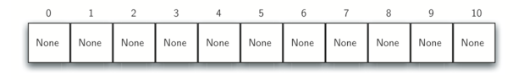
Hash table
A hash table is a collection of items which are stored in such a way as to make it easy to find them later. Each position of the hash table, often called a slot, can hold an item and is named by an integer value starting at 0. For example, we will have a slot named 0, a slot named 1, a slot named 2, and so on. Initially, the hash table contains no items so every slot is empty. The following figure shows a hash table of size m=11. In other words, there are m slots in the table, named 0 through 10.
Figure: Hash table with 11 empty slots

Slide 26
Hash table
The mapping between an item and the slot where that item belongs in the hash table is called the hash function. The hash function will take any item in the collection and return an integer in the range of slot names, between 0 and m-1. Assume that we have the set of integer items 54, 26, 93, 17, 77, and 31. Our first hash function, sometimes referred to as the “remainder method,” simply takes an item and divides it by the table size, returning the remainder as its hash value (h(item)=item%11). Table 4 gives all of the hash values for our example items. Note that this remainder method (modulo arithmetic) will typically be present in some form in all hash functions, since the result must be in the range of slot names.

Slide 27
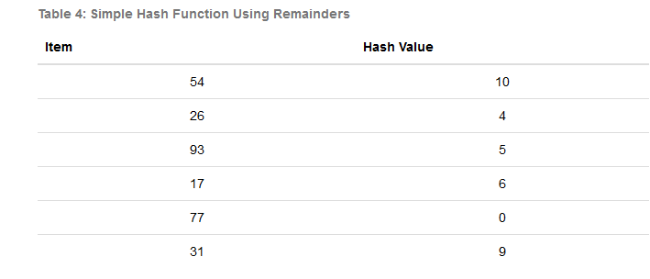
Hash table

Slide 28
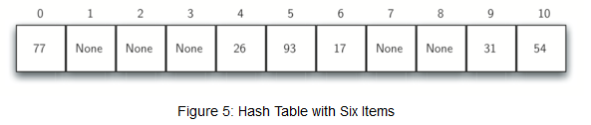
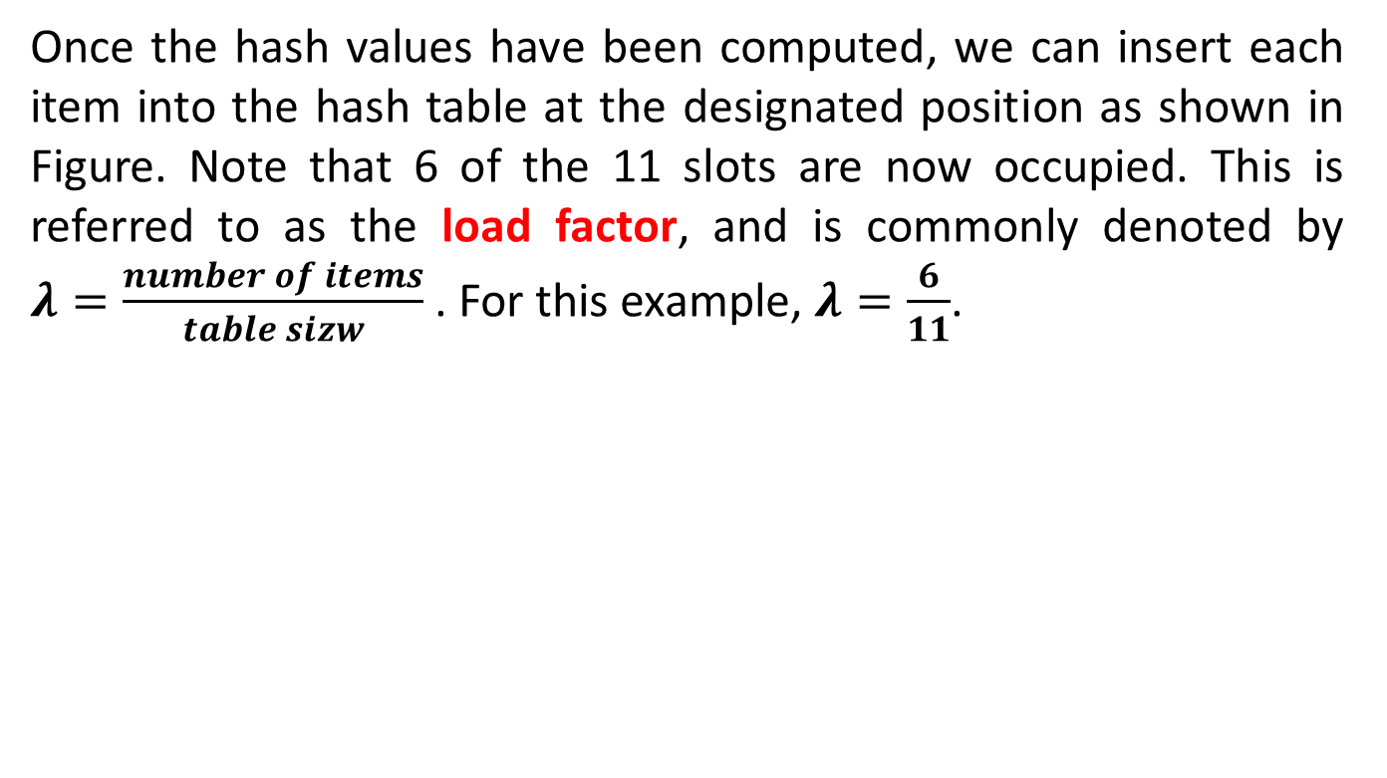
Hash table
Once the hash values have been computed, we can insert each item into the hash table at the designated position as shown in Figure. Note that 6 of the 11 slots are now occupied. This is referred to as the load factor, and is commonly denoted by $λ=\frac{number of items}{table sizw}$ . For this example, $λ=\frac{6}{11}$.

Slide 29
Hash table
Now when we want to search for an item, we simply use the hash function to compute the slot name for the item and then check the hash table to see if it is present. This searching operation is O(1), since a constant amount of time is required to compute the hash value and then index the hash table at that location. If everything is where it should be, we have found a constant time search algorithm.

Slide 30
Hash table
You can probably already see that this technique is going to work only if each item maps to a unique location in the hash table. For example, if the item 44 had been the next item in our collection, it would have a hash value of 0 (44%11==0). Since 77 also had a hash value of 0, we would have a problem. According to the hash function, two or more items would need to be in the same slot. This is referred to as a collision (it may also be called a “clash”). Clearly, collisions create a problem for the hashing technique.

Slide 31
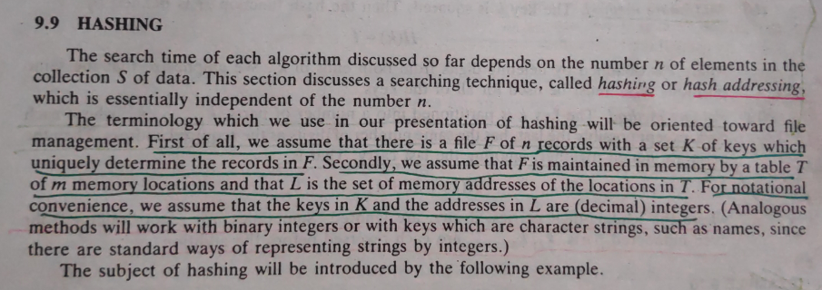
Hashing

Slide 32
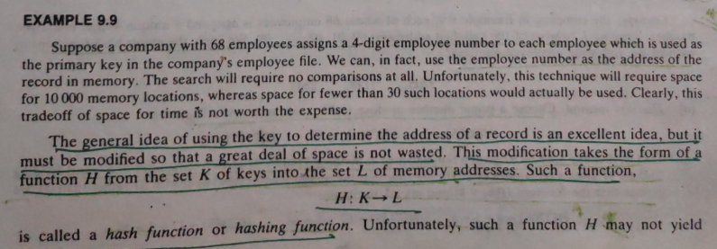
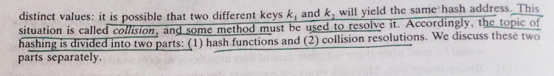
Hashing

Slide 33
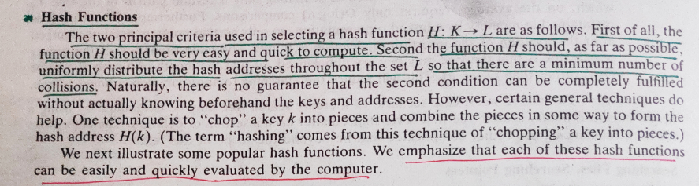
Hashing

Slide 34
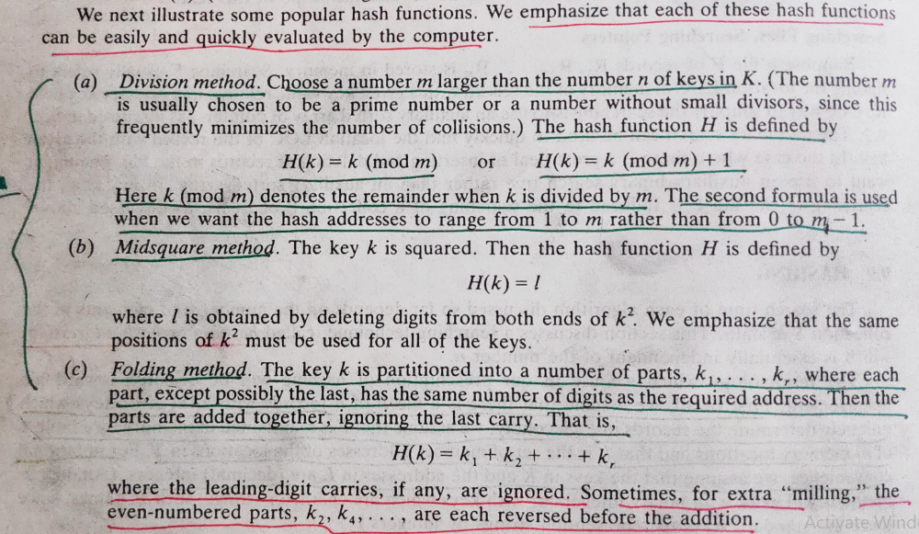
Hashing

Slide 35
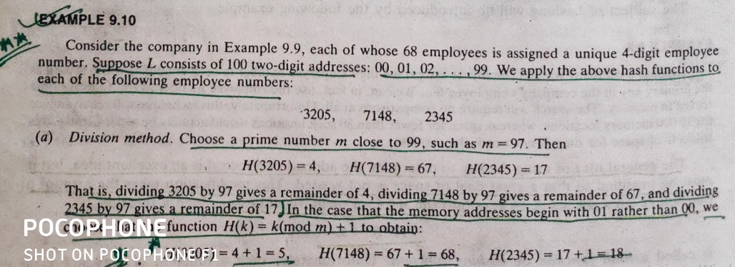
Example

Slide 36
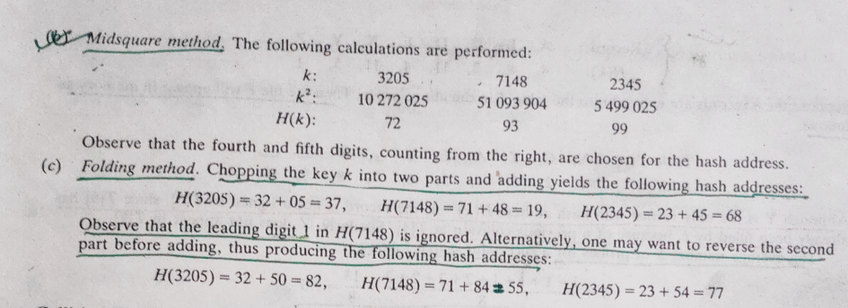
Example

Slide 37
Thank you……

